Slide 1
HACKTON 1
ELECTION DATASET

Slide 2
THE VARIABLES IN THE STATE ELECTION DATA FILE ARE
state election data
Team number:6
Aruna, Bala, srinivasan, shanmugam

Slide 3
THIS IS VARIABLE DECLATION TABLE
Variable name | Storage type | Variable contents
St _ name | str35 | State
Year | int | General election year
Pc no | Byte | Parliamentary constituency number
pc_name | str25 | Parliamentary constituency name
pc_type | str3 | Parliamentary constituency reservation status
cand_name | str70 | Candidate name
cand_sex | str1 | Candidate sex
partyname | str57 | Party name
partyabbre | str10 | Party abbreviation
totvotpoll | Long | Votes received

Slide 4
KEYNOTE
Larger and more populous districts;
Districts contested by multiple parties and candidates;
Legislatures that more proportionately reflect voters' political preferences;
Governing by a coalition of parties rather than one single majority party;

Slide 5

INDIAN Constituencies
India is a Democratic country
The country has been divided into 543 Parliamentary Constituencies

Slide 6

slogan

Slide 7
STATICS AT A GLANCE
THE DEMOGRAPHICS
Total Population | 1.2 billion
Total Area | 3.3 million km2
Number of Electors | 834,082,814 (compared to 173,212,343 in1951-52)
Male Voters | 437,035,372
Female Voters | 397,018,915
Third Gender | 28,527
Youth (18-19) | 13,430,193
Total No. of Polling Stations, Total No. of Assembly Constituencies at Present | 9,27,553 4,120

Slide 8
THE PARLIAMENT
Rajya Sabha | Not more than 250 members (243 at present); 12 members are nominated by the President under Article 80 of the Constitution
Lok Sabha | 543 members plus 2 members of the Anglo-Indian community, nominated by the President under Article 331 of the Constitution

Slide 9
POLITICAL PARTIES
Political Parties | Total | Participated in 2014 polls
National Parties | 6 | 6
State Recognised Parties | 47 | 39
Registered Unrecognised Parties | 1593 | 419
Total No. of Political Parties | 1646 | 464
Total No. of Candidates |  | 8251

Slide 10
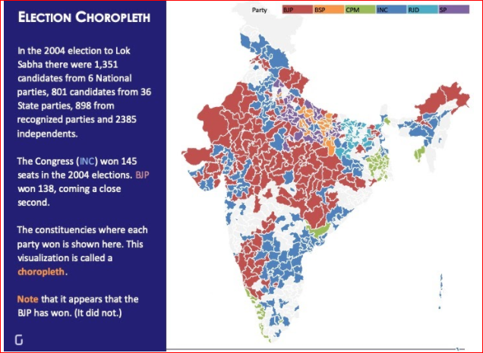
ELECTION CHOROPLETH

Slide 11
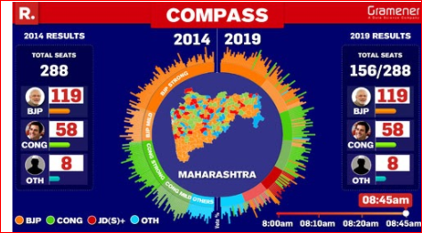
ELECTION COMPASS

Slide 12
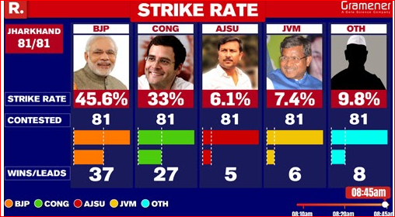
STRIKE RATE

Slide 13
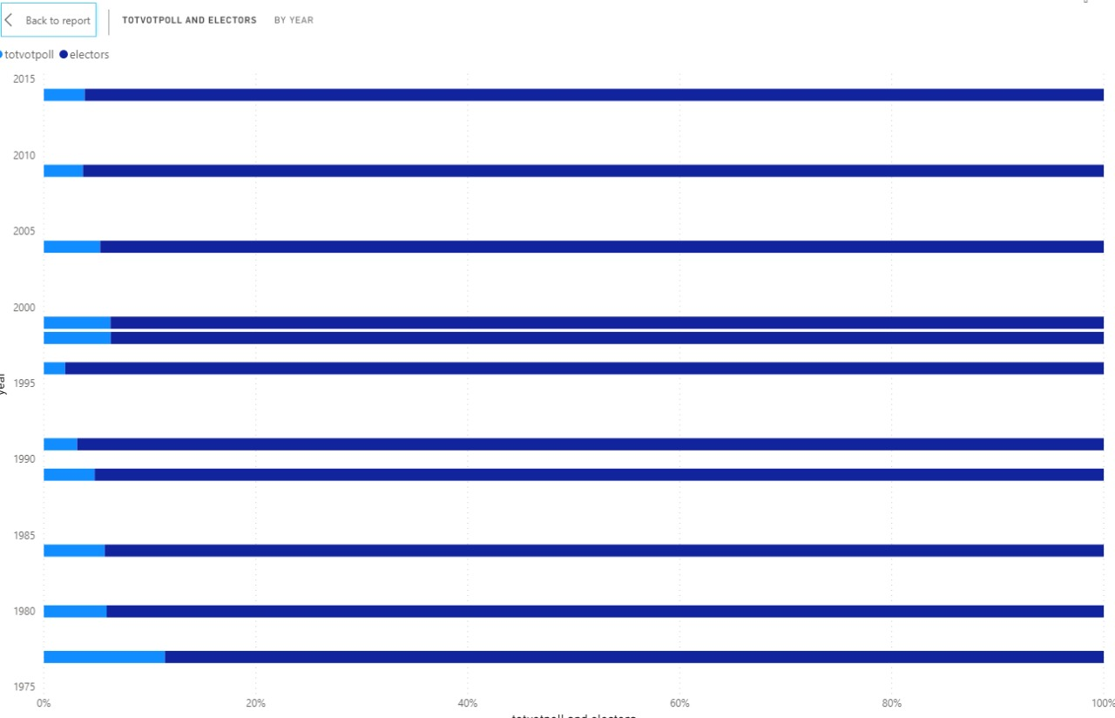
PLOTTING

Slide 14
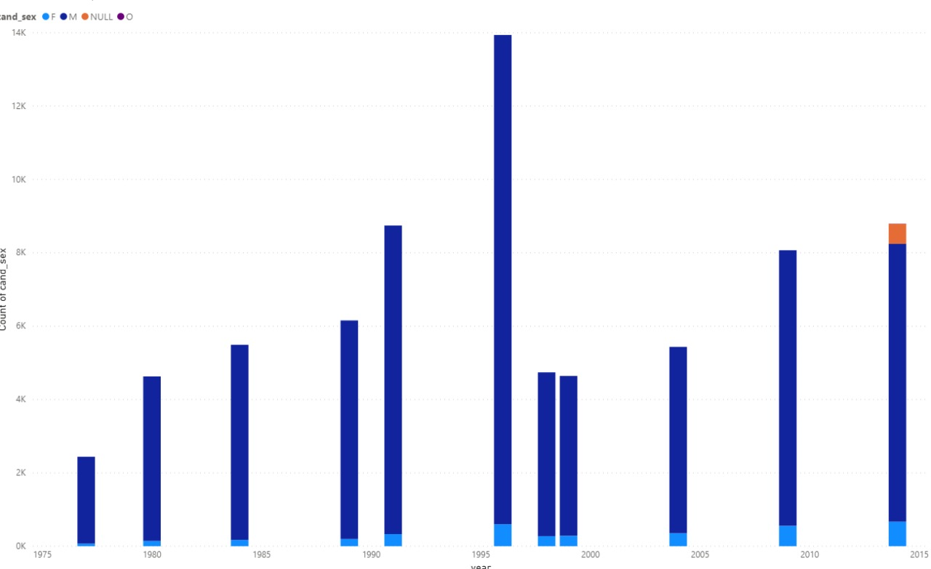
PLOTTING THE DATA

Slide 15
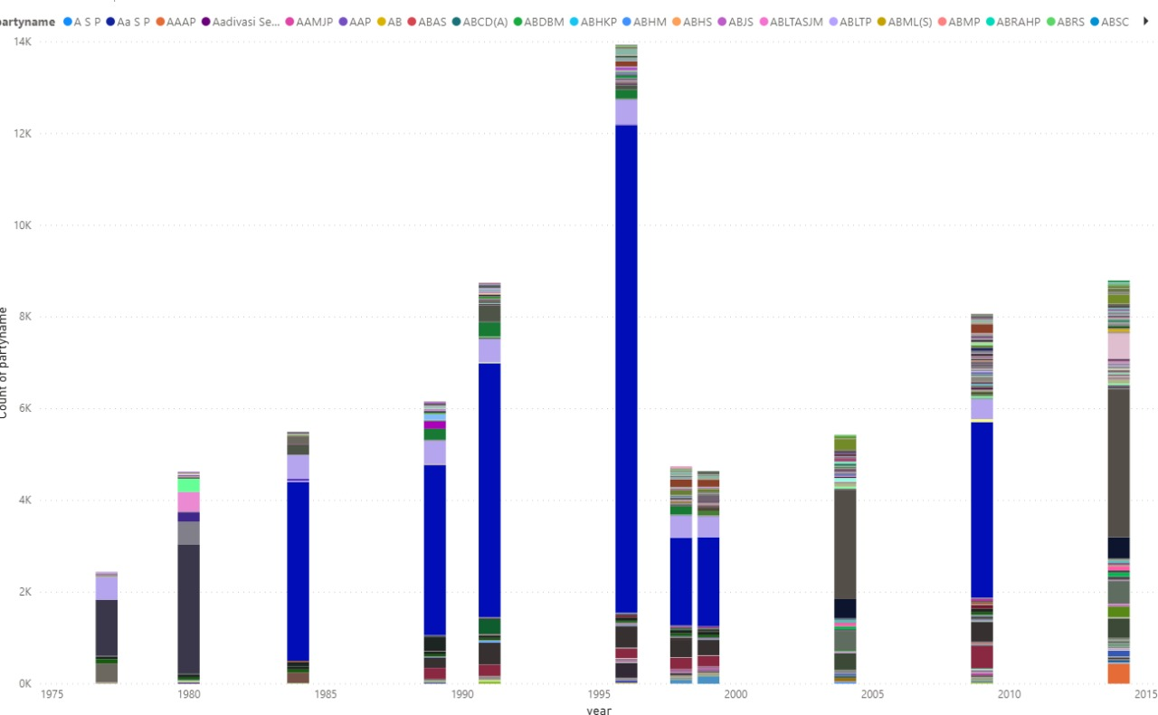
BREAK METHOD

